Slide 1
What is Java Virtual Machine (JVM)

Slide 2
Java has been designed to run on variety of platforms with the concept “write once, run anywhere(WORA)”. What does this mean? Unlike programming languages like C++ for example, where the code is compiled for a specific platform and runs natively on it, Java source code is first compiled into bytecode – a .class file. Once compiled the class file is interpreted by the virtual machine (VM).

Slide 3
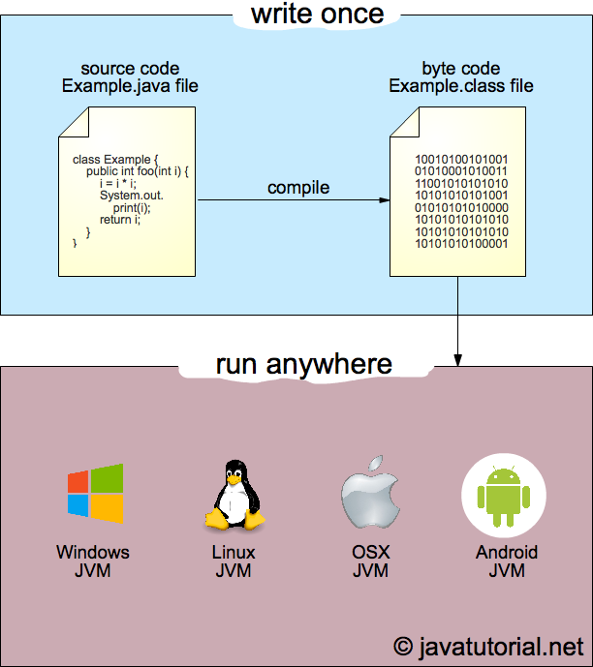

Slide 4
The Java virtual machine consists of three main areas:
Class loader subsystem
Runtime data area
Execution engine

Slide 5
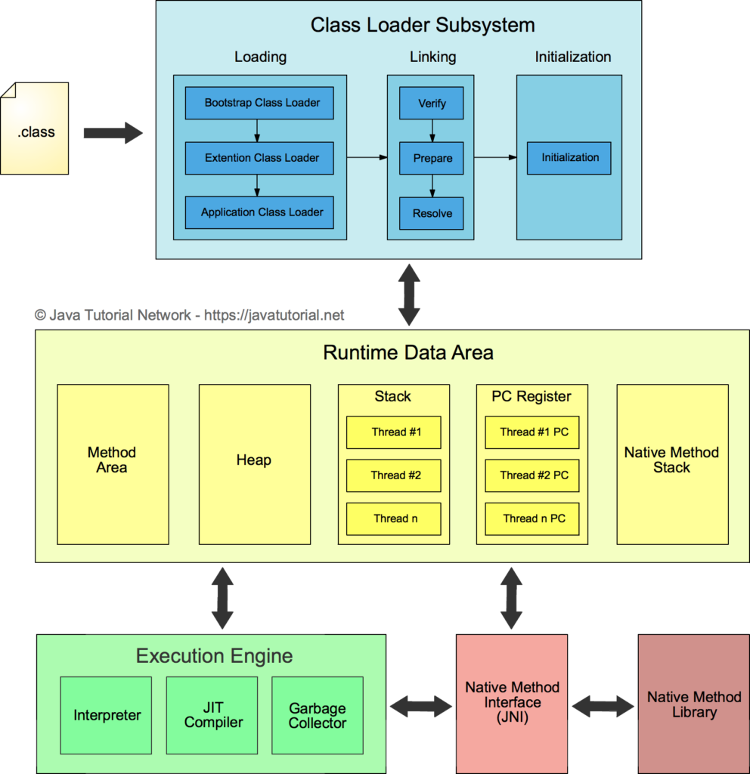

Slide 6
Class Loader Subsystem
Loading
Compiled classes are stored as a .class file. When we try to use a Class, Java Class Loader loads that class into memory. Classes are introduced into the Java environment when they are referenced by name in a class that is already running. Future attempts at loading classes are done by the class loader, once the first class is running. Running the first class is usually done by declaring and using a static main() method.

Slide 7
There are three types of class loaders:
Bootstrap Class Loader It loads JDK internal classes, typically loads rt.jar and other core classes for example java.lang.* package classes
Extensions Class Loader It loads classes from the JDK extensions directory, usually lib/ext directory of the JRE.
System Class Loader Loads classes from system classpath, that can be set while invoking a program using -cp or -classpath command line options.

Slide 8
Linking
Linking a class or interface involves verifying and preparing that class or interface, its direct superclass, its direct superinterfaces, and its element type if necessary.
JVM requires that all of the following properties are maintained:
A class or interface is completely loaded before it is linked.
A class or interface is completely verified and prepared before it is initialized.
Errors detected during linkage are thrown at a point in the program where some action is taken by the program that might, directly or indirectly, require linkage to the class or interface involved in the error

Slide 9
Initialization
Initialization of a class or interface consists of executing its class or interface initialization method or calling the class’s constructor for example.
Because the Java Virtual Machine is multithreaded, initialization of a class or interface requires careful synchronization, since some other thread may be trying to initialize the same class or interface at the same time.
This is the final phase of Class Loading, here all static variables will be assigned with the original values, and the static block will be executed.

Slide 10
Class Method Area: In the memory, there is an area where the class data is stored during the code's execution. Class method area holds the information of static variables, static methods, static blocks, and instance methods.
Heap: The heap area is a part of the JVM memory and is created when the JVM starts up. Its size cannot be static because it increase or decrease during the application runs.
Stack: It is also referred to as thread stack. It is created for a single execution thread. The thread uses this area to store the elements like the partial result, local variable, data used for calling method and returns etc.
Native Stack: It contains the information of all the native methods used in our application.

Slide 11
Execution Engine: It is the central part of the JVM. Its main task is to execute the byte code and execute the Java classes. The execution engine has three main components used for executing Java classes.
Interpreter: It converts the byte code into native code and executes. It sequentially executes the code. The interpreter interprets continuously and even the same method multiple times. This reduces the performance of the system, and to solve this, the JIT compiler is introduced.
JIT Compiler: JIT compiler is introduced to remove the drawback of the interpreter. It increases the speed of execution and improves performance.
Garbage Collector: The garbage collector is used to manage the memory, and it is a program written in Java. It works in two phases, i.e., Mark and Sweep. Mark is an area where the garbage collector identifies the used and unused chunks of memory. The Sweep removes the identified object from the Mark
Java Native Interface
Java Native Interface works as a mediator between Java method calls and native libraries.

